Slide 1


Okta Terrify
Persistence in a Passwordless World

Slide 2
whoami
Ceri Coburn (@_EthicalChaos_)
Software developer for 18 years within the DRM and security solutions space
Moved to offensive security in 2019
Dedicated to Red Teaming and offensive security tooling for the last 3 years
Speaker at DEF CON and BSides
Author of several tools released to the community including BOF.NET, SweetPotato and SharpBlock
Member of the Rubeus maintainer team

Slide 3
What we will cover
A high-level overview of passwordless solutions
What is Okta Verify and Okta FastPass
Reversing Okta Verify functionality
Abusing enrolled Okta devices
Okta Terrify tool demonstration
Q&A

Slide 4

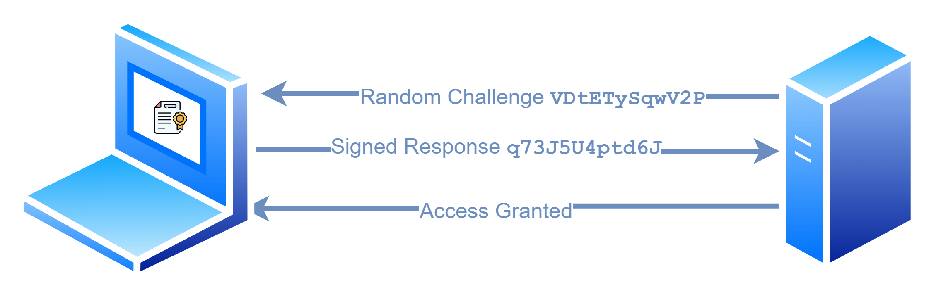
What is passwordless?
Centres around public key crypto
Application registers one or more devices identified by public keys
Public key is stored during registration
Random challenge signed with private key during authentication
FIDO2 is an open specification around this process
Not all applications follow FIDO2
Registration
Authentication

Slide 5
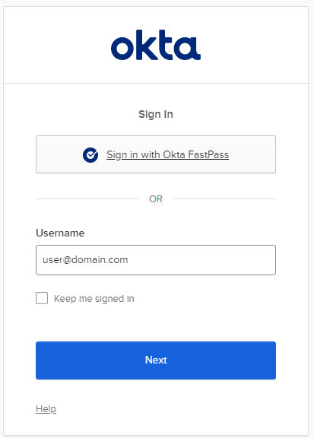
Okta Verify and FastPass
Endpoint application used for okta multifactor authentication
Supported on multiple platforms
Handles TOTP code, push notification and FastPass
FastPass is okta’s implementation of passwordless
Does not follow FIDO2, but principles are the same

Slide 6
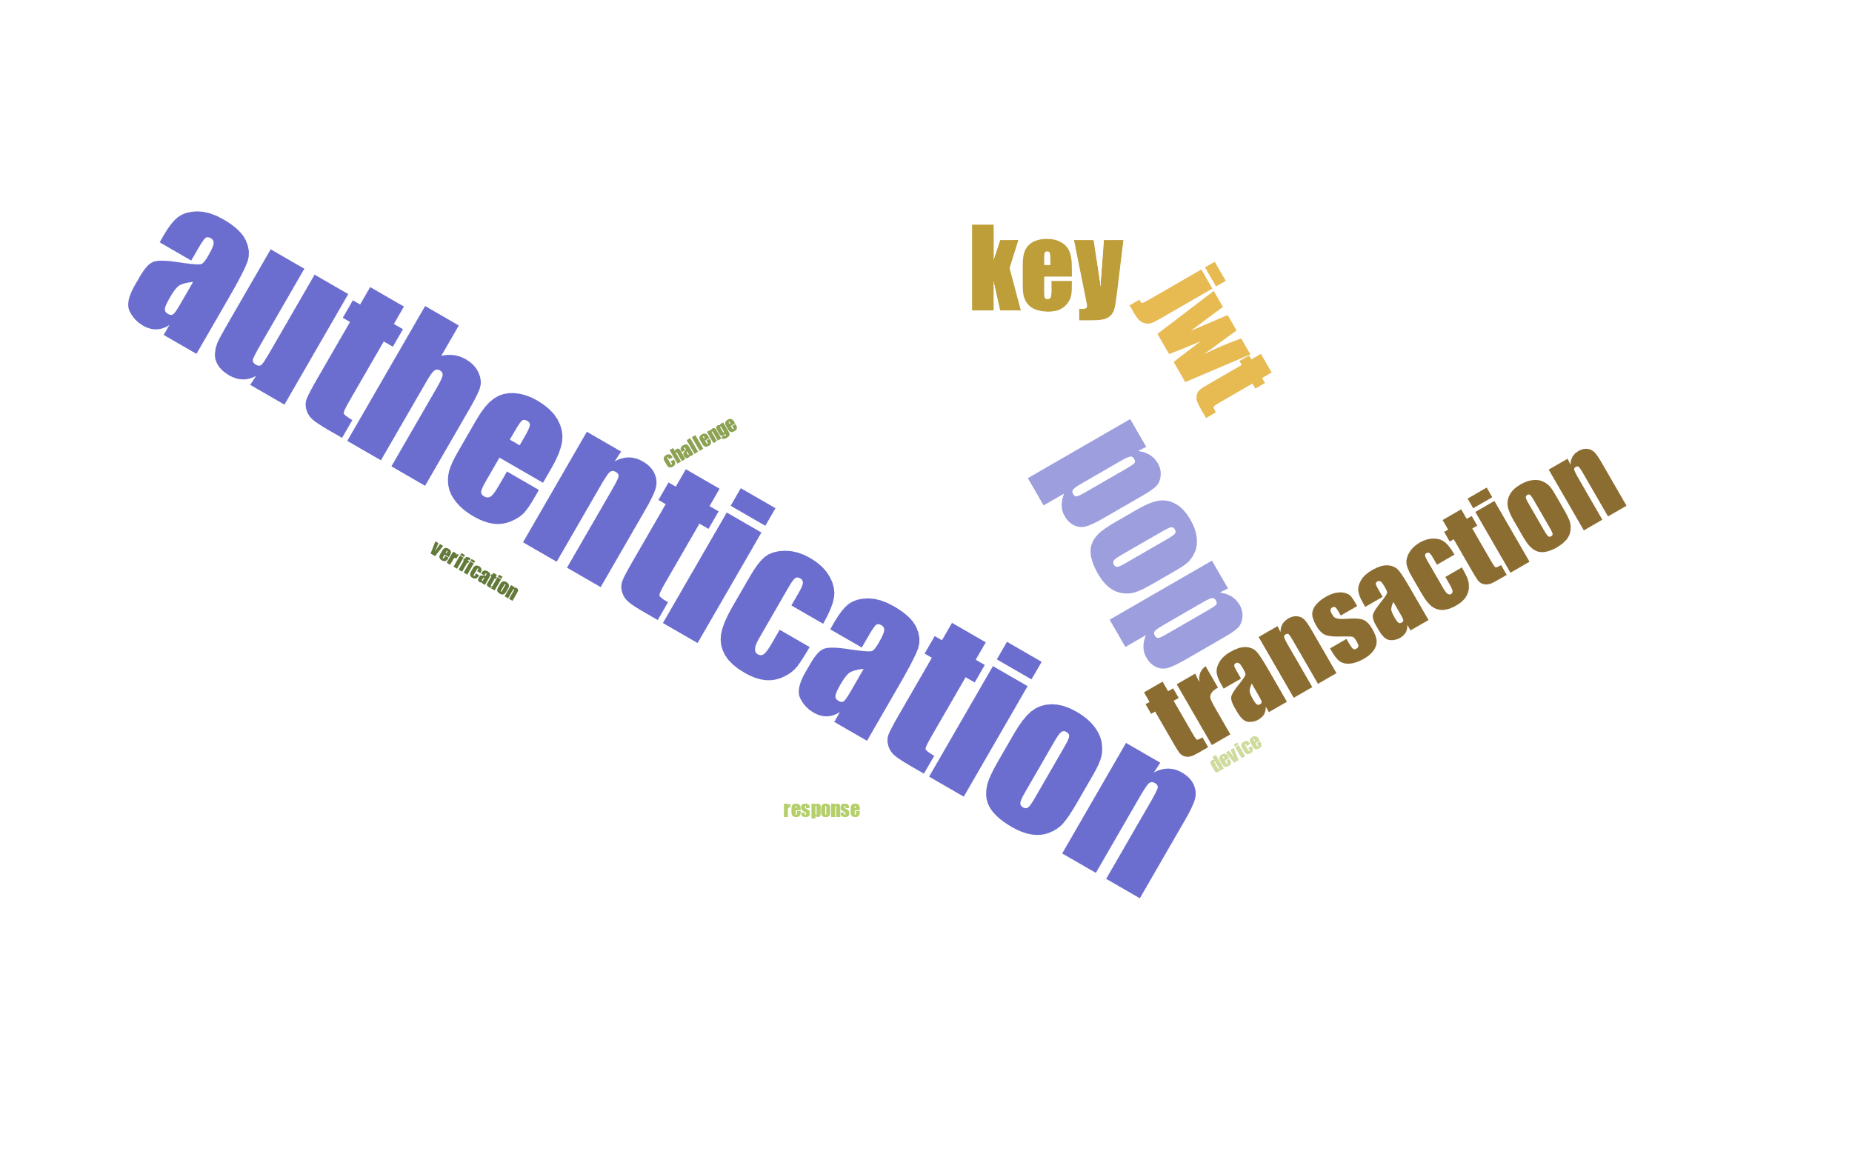
Okta Terminology
Device
Represents a unique device attached to a user account
Authenticator
Represents an authenticator type supported by a device, for example key, TOTP, etc…
User Verification Key
The key used as the basis for passwordless login.
PoP Key
A proof of possession key that will satisfy one factor during a multifactor authentication flow. Also know as silent key
Transaction
Transaction representing a single authentication flow
Challenge
JWT token sent to okta verify application to initiate authentication flow
Response
Signed JWT response to the initial challenge
Nonce
A random sequence included within a challenge and repeated during the response

Slide 7
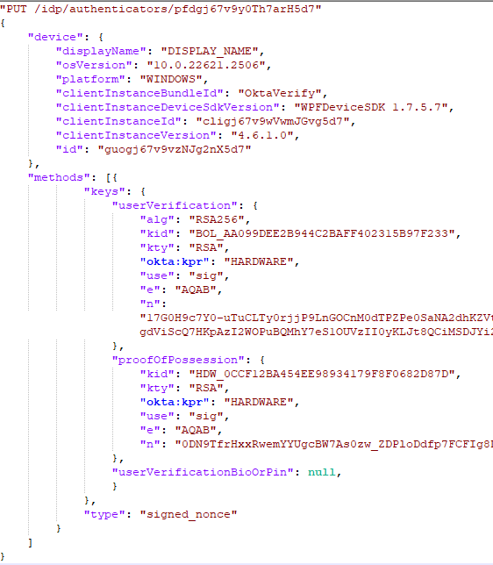
Okta Verify Registration
OAuth2 based flow
Client ID: okta.63c081db-1f13-5084-882f-e79e1e5e2da7
Scope: openid profile okta.authenticators.read okta.authenticators.manage
Callback: http://localhost:65112/login/callback
MFA Required
Existing MFA method needed if already set

Slide 8
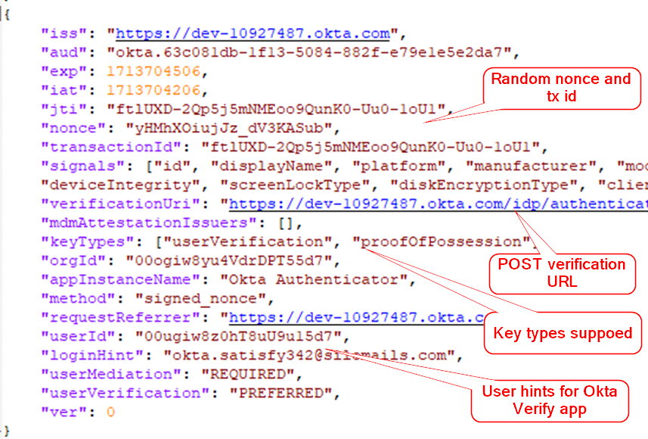
Okta Verify Authentication
Browser sends JWT challenge to Okta Verify
Web server listens on port 8769 – POST /challenge
Customer URL handler com-okta-authenticator://
Out of band polling by browser
Okta Verify submits signed JWT response directly to verificationUri
Challenge
Notes:
Verification URL user for POST call back
Key Type: Supported key types allowed for authentication
Signals: Can be used for device attestation, for example checking fully up to date or running antivirus

Slide 9
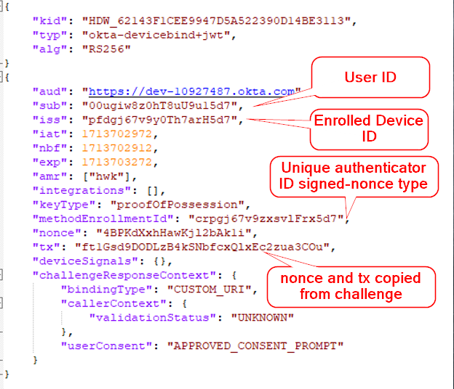
Okta Verify Authentication
Browser sends JWT challenge to Okta Verify
Web server listens on port 8769 – POST /challenge
Customer URL handler com-okta-authenticator://
Out of band polling by browser
Okta Verify submits signed JWT response directly to verificationUri
Response
Notes:
keyType: Used to indicate which key type was used to signed the JWT
deviceSignals: Can be blank if not enforced, equally can be faked if enforced within the tenant
userConsent: An indicator to the server if the user approved the authentication challenge, also can be faked

Slide 10
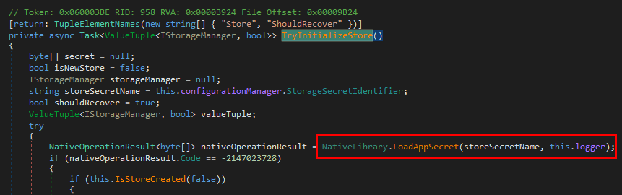
Reversing Okta Verify
First challenge – where and how was the information stored?
Predominantly .NET based Application
Security code implemented in native DLL’s
%LocalAppData%\Okta\Verify\OVStore.db (Legacy)
%LocalAppData%\Okta\Verify\DataStore.db (Newer)
Encrypted SQLite Database

Slide 11
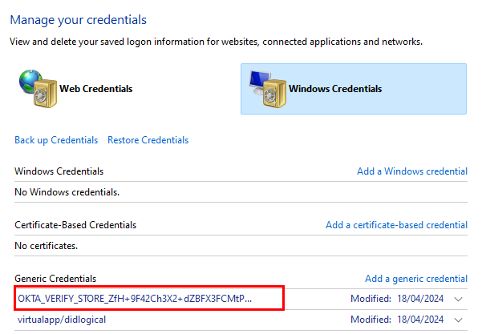
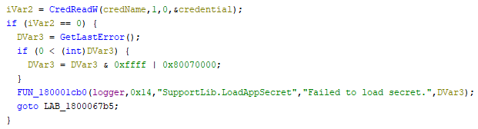
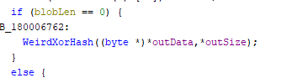
Reversing Okta Verify
First challenge – where and how was the information stored?
Predominantly .NET based Application
Security code implemented in native DLL’s
%LocalAppData%\Okta\Verify\OVStore.db (Legacy)
%LocalAppData%\Okta\Verify\DataStore.db (Newer)
Encrypted SQLite Database
CredName = “OKTA_VERIFY_STORE_” + BASE64(SHA256(SID))

Slide 12
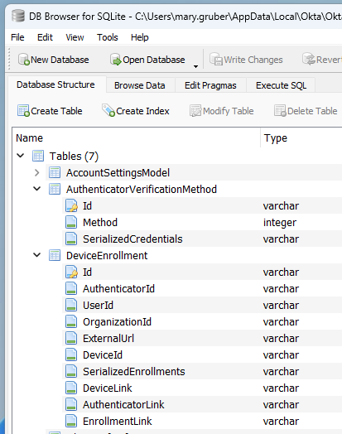
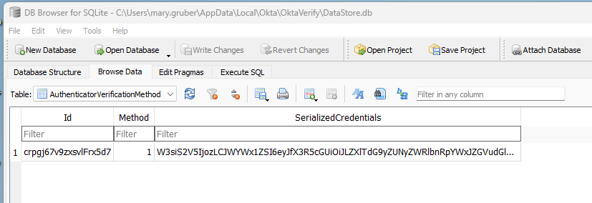
Reversing Okta Verify
First challenge – where and how was the information stored?
Predominantly .NET based Application
Security code implemented in native DLL’s
%LocalAppData%\Okta\Verify\OVStore.db (Legacy)
%LocalAppData%\Okta\Verify\DataStore.db (Newer)
Encrypted SQLite Database

Slide 13
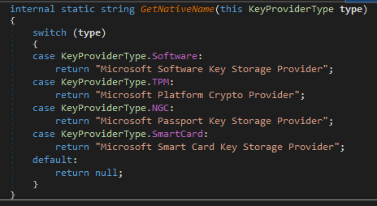
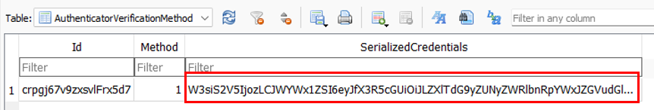
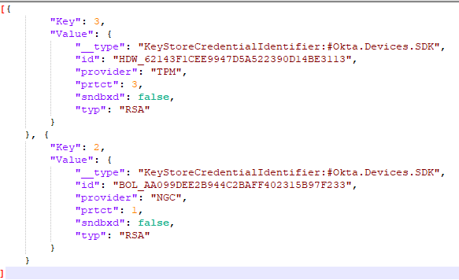
Where art thou keys?
Second challenge – Where are the keys?
Leverages Windows Crypto API
TPM for proofOfPresence key if available
Windows Hello for userVerification key if available
Otherwise, keys stored using software backed key store

Slide 14
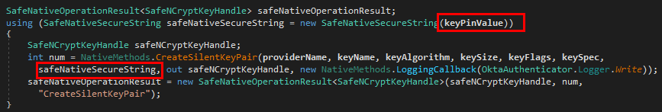
The not so silent key
PoP key also known as the silent key
Silent = no user verification via typed PIN
Key was still protected with a PIN, programmatically
Once again, logic hidden behind native library

Slide 15
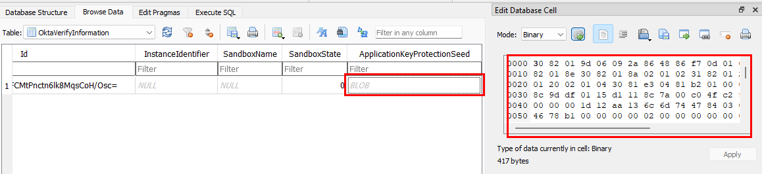
The not so silent key
ApplicationKeyProtectionSeed stored inside SQLite database
Value sent to LoadClientAssociation native function
Result used as PIN when signing data with silent key

Slide 16
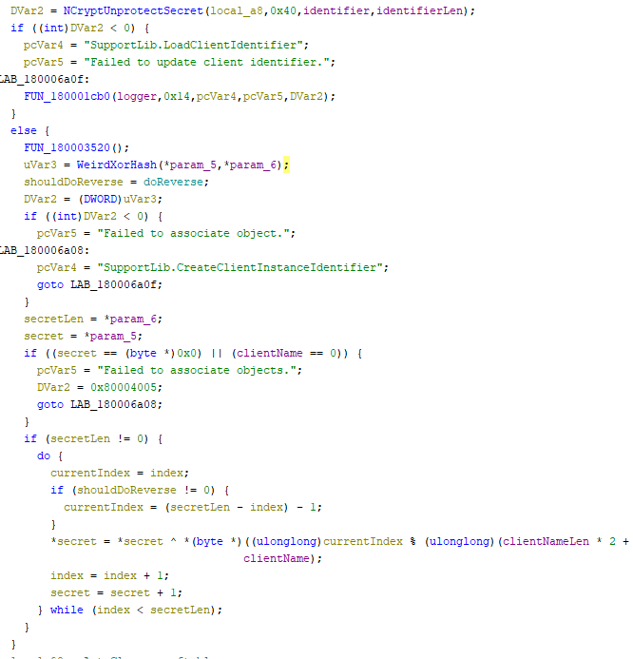
The not so silent key
Blob decrypted with DPAPI-NG API
Same weird XOR hash
PIN = XOR(secret, reverse(clientName))

Slide 17
What have we learned?
Okta stores data inside encrypted SQLite database, key generated from users SID + secret stored inside Windows CredMan
Two types of keys enrolled, PoP and userVerification.
PoP key is protected with PIN set programmatically and acts as a single factor
userVerification key acts as both factors and is the basis for FastPass based logins
Keys are generated and stored using platform crypto API. TPM and Windows Hello if available, software if not

Slide 18
Passwordless Persistence
Passwordless is phish proof, but what about compromised endpoints?
Software keys are a huge risk, these can simply be exfiltrated and used away from the enrolled Okta Verify device
Hardware protection is better, but we can still proxy signing requests
Enrol new devices
Or better yet, piggyback of existing devices…

Slide 19
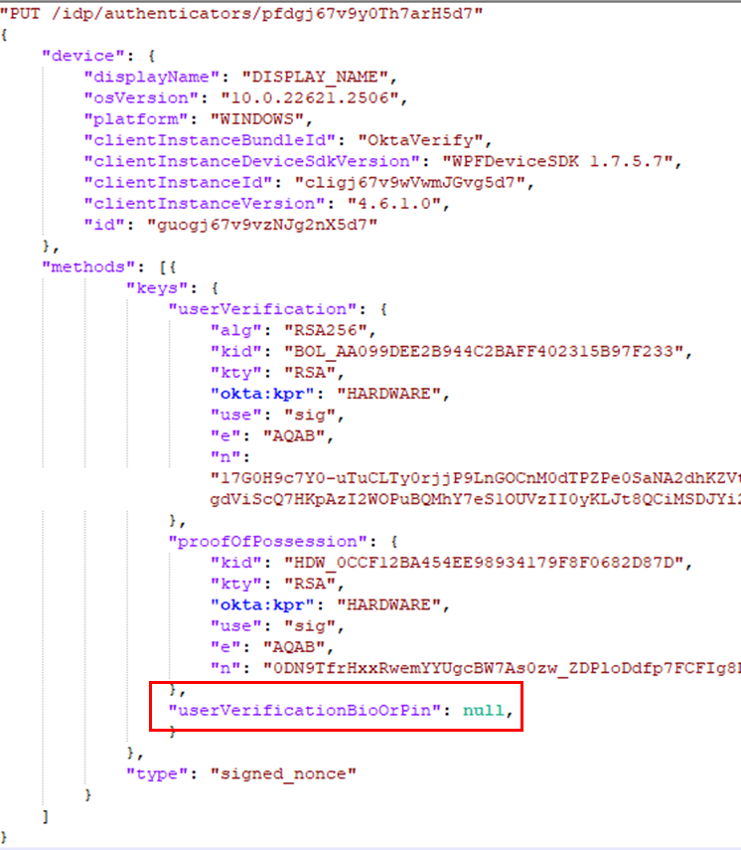
Passwordless Persistence
Multiple key slots for a single device
Can we enrol a second userVerification key?

Slide 20
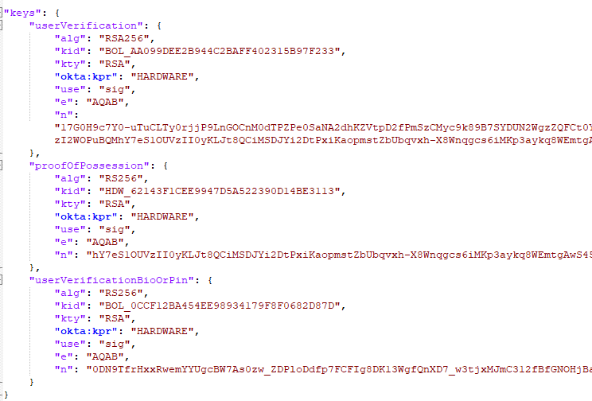
Passwordless Persistence
Yes, we can.
Original Keys
Backdoor Key

Slide 21
Demo
OktaTerrify
Implements the Okta Verify challenge protocol
Parses exfiltrated DataStore.db
Generates signing requests for OktaInk
Generates and stores persistent backdoor keys from the attacking host
OktaInk
Lighter weight tool to run on compromised endpoint
Performs signing requests for either the PoP key or userVerification key
Calculates DataStore.db keys
Dump software backed keys

Slide 22
Closing Remarks
Abuse vectors not limited to Okta
Proxy signing will be possible on most platforms
Better on app isolation platforms
Keystores can be unique per application
Rooting/jailbreaking required to use outside of application
Or application itself would need to be compromised
Additional considerations during account recovery
Can you guarantee any enrolled devices have not been modified?
All enrolled MFA methods should be revoked including the usual password change

Slide 23
Q & A

Slide 24



@_EthicalChaos_
Thanks
for Listening
@CCob
ethicalchaos.dev

